Slide 1
Auto-INSURANCE
Group 04 (Section 001)

Slide 2

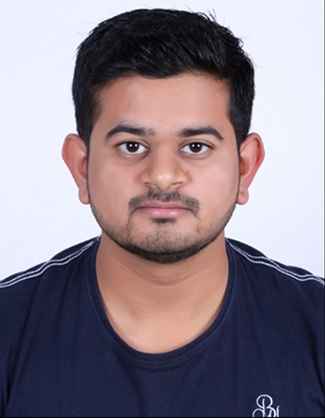
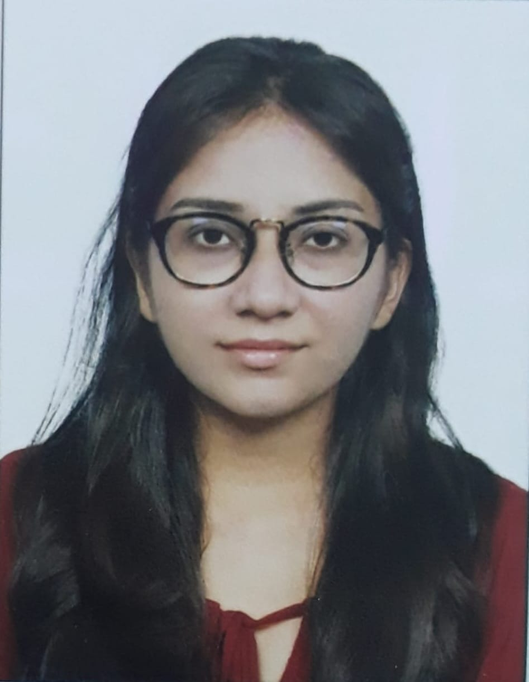

MEET OUR TEAM Group 04(section-001)
Bhumit Navadiya
Jaykumar Mangroliya
Khushi Patel
Hiren Koradiya

Slide 3
AGENDA
Background/Motivation
Problem Statment
Proposal
Analysis Questions
Dataset Description
EDA and Visualization
Jira work Management
Github work
Reference

Slide 4
Background/Motivation
The number of accidents are increasing as compared to past years.
SOURCE: United States Department of Transportation
https://www.nhtsa.gov/press-releases/early-estimates-first-quarter-2022
The increasing ratio of accidents often result in larger claim amounts which is the primary way of making profit for insurance companies (known as underwriting profit). This motivated us to help insurance companies with an analysis model which will help them revise their policies and premiums to maximize their profit.
https://www.fe.training/free-resources/fig/how-do-insurance-companies-make-money/
This will be done by finding major trends and patterns in the insurance claims to help insurance companies gain insights into the factors that affect their profit and help guide them into understanding the factors they need to focus upon when making changes to the policies.
We will also be working with this auto insurance data to demonstrate how we can create a model that analyzes frauds in insurance

Slide 5
Problem Statement
It is causing a cascading effect in the amount of insurance claims and frauds that are happening. Majority insurance companies are focusing more on improvements according to these changes to direct the sales and business path. Our analysis will facilitate the same.
SOURCE: https://www.semutual.nb.ca/news/insurance-fraud/

Slide 6
Proposal
The primary focus as target audience are the insurance companies.
Our goal is to create analysis to recognize patterns in claim amounts and accidents to help insurance revise their policies, which help maximize their profit margin.

Slide 7
Analysis Questions:
Analyze which states have higher accidents?
Which severity class had a greater number of incidents? Also analyze which gender is higher for each one.
After an accident which authorities were contacted?
Analyse for both gender premium amount and total claim amount.

Slide 8
Data Description

Slide 9
Dataset Description
Auto-Insurance
Categorical Variables
policy_bind_date
policy_state
policy_csl
insured_sex
insured_education_level
insured_occupation
insured_hobbies
insuredrelationship
incident_type
Numeric Variables
months_as_customer
age
policy_number
policy_annual_premium
umbrella_limit
insured_zip
capital-gains
capital-loss
This is a US insurance companies dataset collected from multiple data points, uploaded on databricks. This is for the year of 2015 and covers months of January, February and March.

Slide 10
Dataset Description
Fields | About
months_as_customer
Age | Factor with levels alive dead
policy_number | A factor with levels none airbag
policy_bind_date | A factor with levels none belted
Policy_state | A numeric vector; 0 = non-frontal, 1=frontal impact
Policy_csl | A factor with levels f m
Policy_deductable | Age of occupant in years
Policy_annual_premium | Year of accident
Umbrella_limit | Year of model of vehicle; a numeric vector
Insured_zip | Did one or more (driver or passenger) airbag(s) deploy? This factor has levels deploy nodeploy unavail
Insured_sex | a factor with levels driver pass
Insured_education_level | a numeric vector: 0 if an airbag was unavailable or did not deploy; 1 if one or more bags deployed.
Insured_occupation | a numeric vector; 0:none, 1:possible injury, 2:no incapacity, 3:incapacity, 4:killed; 5:unknown, 6:prior death
Insured_hobbies | character, created by pasting together the populations sampling unit, the case number, and the vehicle number. Within each year, use this to uniquely identify the vehicle.

Slide 11
Data description
Fields | About
Insured_relationship | Number of vehicles included in particular accident.
Capital-gains | Condition of the road while accident occurs.
Capital-loss | Streetlight were lit or not while accident occurs.
Incident_date | It will provide weather condition.
Incident_type | Class of the affected person such as driver, pedestrian or rider.
Collision_type | It will provide the level of seriousness of injury.
Sex of Casualty | Gender
Incident_severity | Gives information of vehicle type.
Authoraties_contacted | It will give the age of affected person.
Incident_state | Date when accident occurs.
Incident_city | Time when accident occurs.

Slide 12
Data description
Fields | About
Incident_location | Number of vehicles included in particular accident.
Incident_hour_of_the_day | Condition of the road while accident occurs.
Number_of_vehicles_involved | Streetlight were lit or not while accident occurs.
Property_damage | It will provide weather condition.
Bodily_injuries | Class of the affected person such as driver, pedestrian or rider.
Witnesses | It will provide the level of seriousness of injury.
Police_report_available | Gender
Injury_claim | Gives information of vehicle type.
Property_claim | It will give the age of affected person.
Vehicle_claim | Date when accident occurs.
Auto_make | Time when accident occurs.

Slide 13
EDA and Visualization

Slide 14
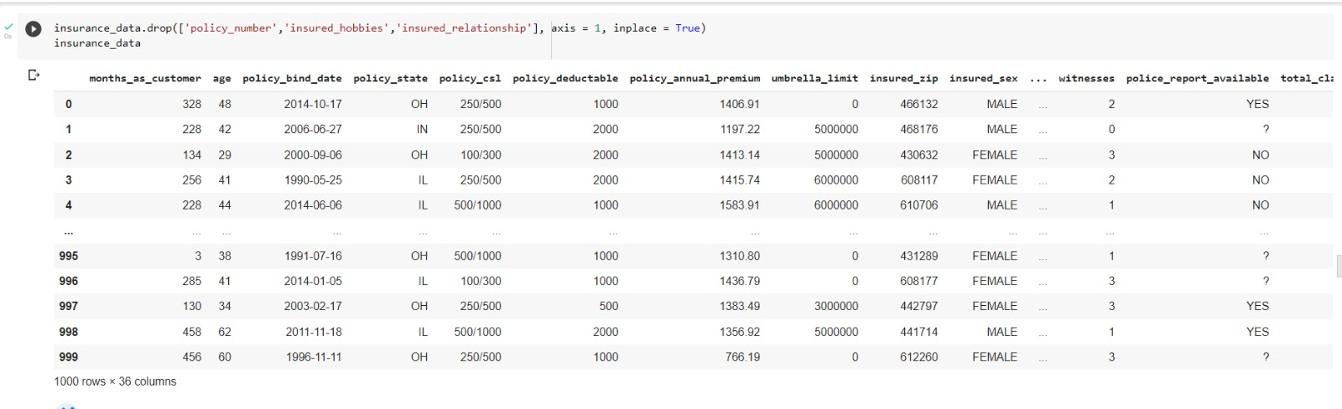
DATA Cleaning
The column of “Policy_number” has many unique values and is also not useful for any insightful visualization and thus is dropped.
The columns of “insured_hobbies” and “insured_relationship” is also not valuable to draw any patterns and thus is removed.

Slide 15
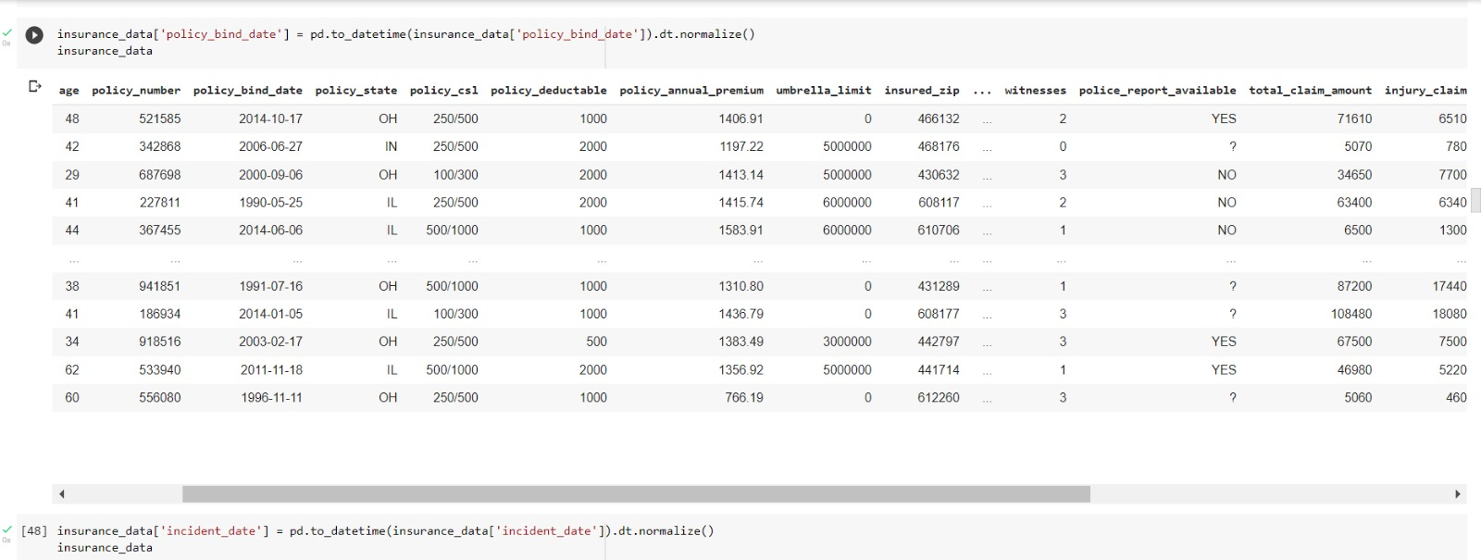
The column of “Policy_bind_date” has time along with the date and in it the time is “00:00” for all rows and is thus removed.

Slide 16
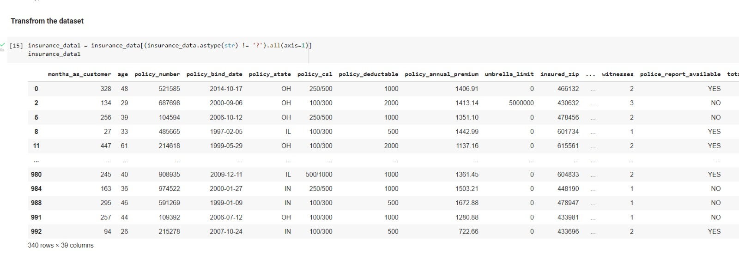
The data has multiple variables that have missing values in the form of “?”, if they are removed then we are left with only 340 rows, this will significantly affect the visualization.
Additionally, some of the rows in which the values are missing is often not used for answering the particular analysis question. Thus it does not make any change even if the missing rows are not removed.

Slide 17
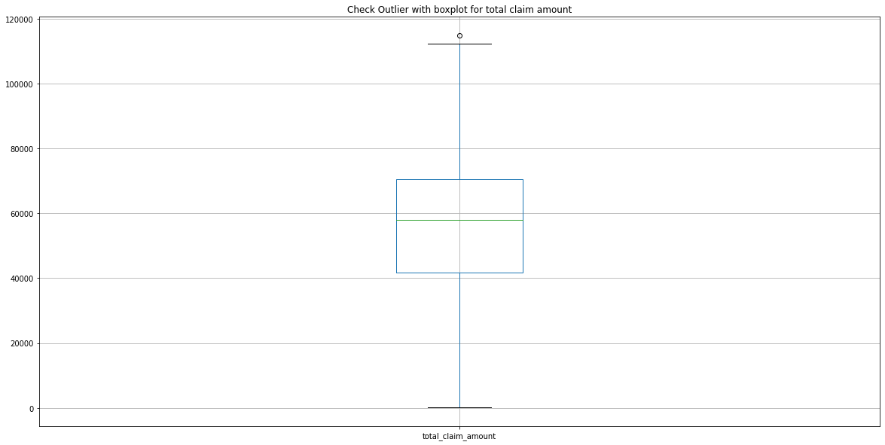
outliers for Total Claim Amount
It is visible from the box plot that there is only one outlier. However, there is no requirement to remove it as it does not have huge difference than the other values and it is a true outlier

Slide 18
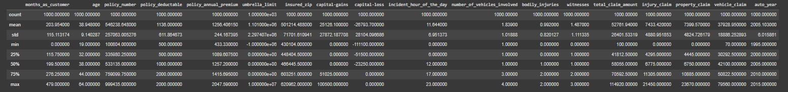
Summary Statistics
Key Observations :
Average year of taking insurance is by age is 19 and maximum is 64 according to the dataset.
Average number of vehicles is 1 for accidents and maximum is 4.
Maximum Total Claim amount is 114920.00 and the maximum claim amount between injury, property and vehicle claim is for vehicle claim at 79580.00

Slide 19
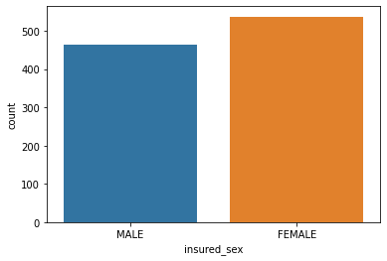
Male vs Female
It can be observed that there is not major difference between the insurance coverage for males and females, however female ratio is higher.

Slide 20
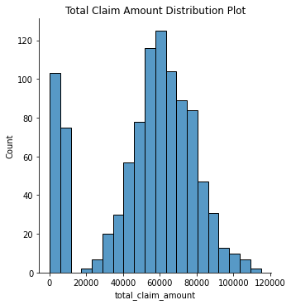
Bar chart of Total claim amount
It can be observed that the data is almost symmetrically distributed.
Which indicate the values occur at regular frequencies and are concentrated near the mean.
It is also visible that the total claim amount few policy holders is zero.

Slide 21
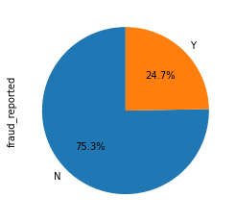
Pie-chart
The visualization describes how much fraud reports has been reported by yes and no in percentage.`
We observe the number of frauds are less compared to true incidents.
However, the ratio of fraud incidents is at 24.7% is not insignificant.

Slide 22
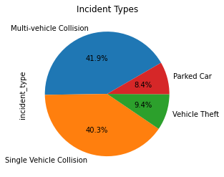
Pie-chart
According to data, multi-vehicle collision incidents are slightly more then single vehicle collision.
Contrary to that, accidents of parked cars and vehicle theft is less than 10 percent then others.

Slide 23
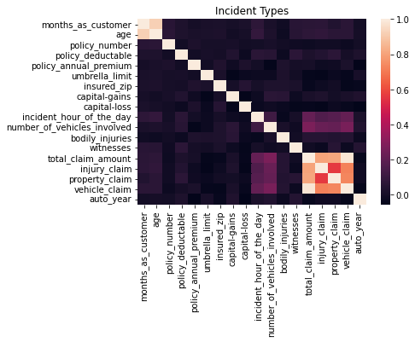
Co-relation
No other significant correlation between any other elements in the dataset.

Slide 24
Data analysis

Slide 25
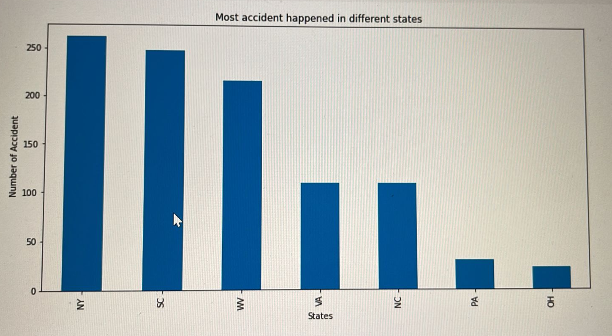
Analyze which states have higher accidents?
This graph helps understand the demographic distribution of accidents across US states.
It can be observed that New York, South Carolina and West Virginia have the highest number of accidents.

Slide 26
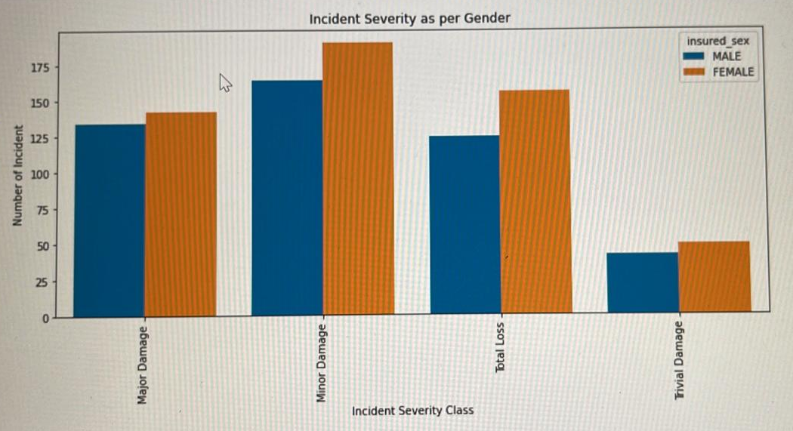
Which severity class had a greater number of incidents? Also analyze which gender is higher for each one.
This histogram compares males to females for the severity of accidents that have happened.
It can be observed that for all severity classes females have higher ration than males.
Additionally, except for trivial damage all other severity class have larger values, implying more claim amounts.

Slide 27
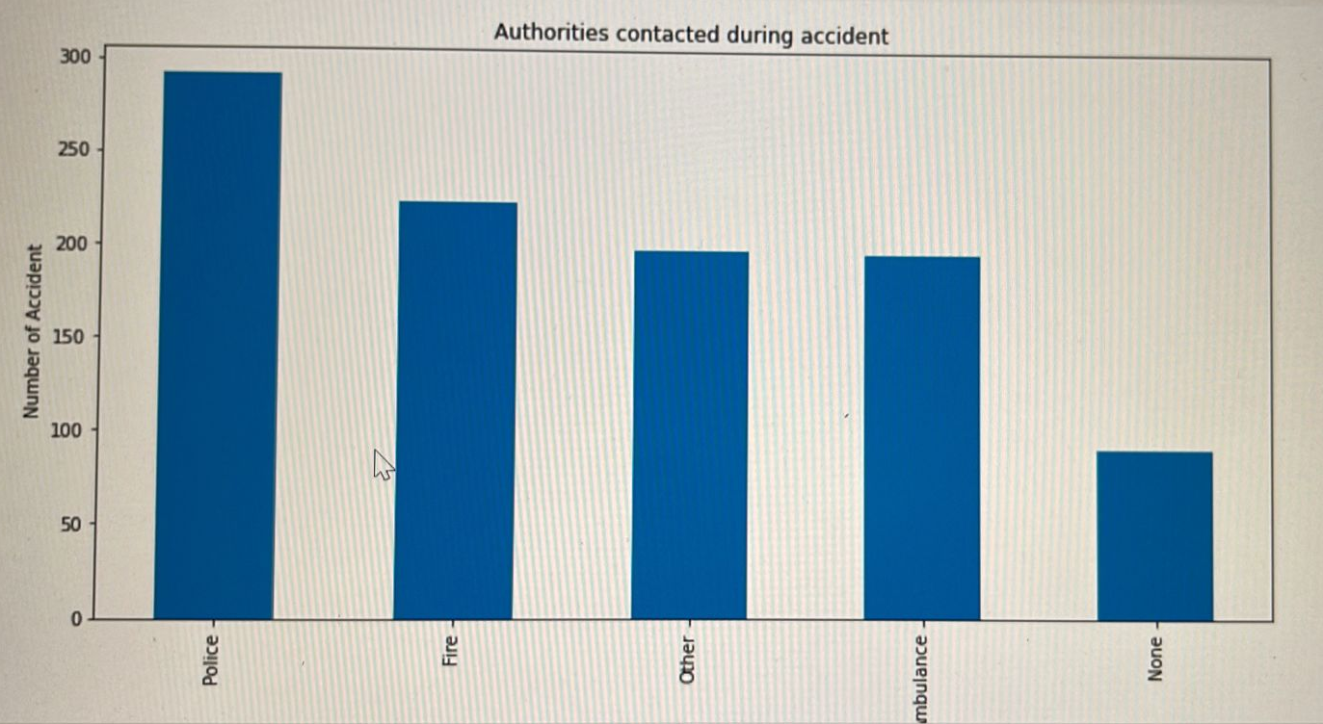
After an accident which authorities were contacted?
This bar graph gives the count for different authorities that were contacted after an accident.
It can be observed that Police was called for majority of the incidents and many accidents did not call any authority.

Slide 28
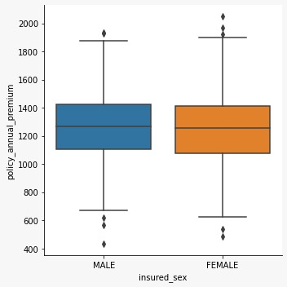
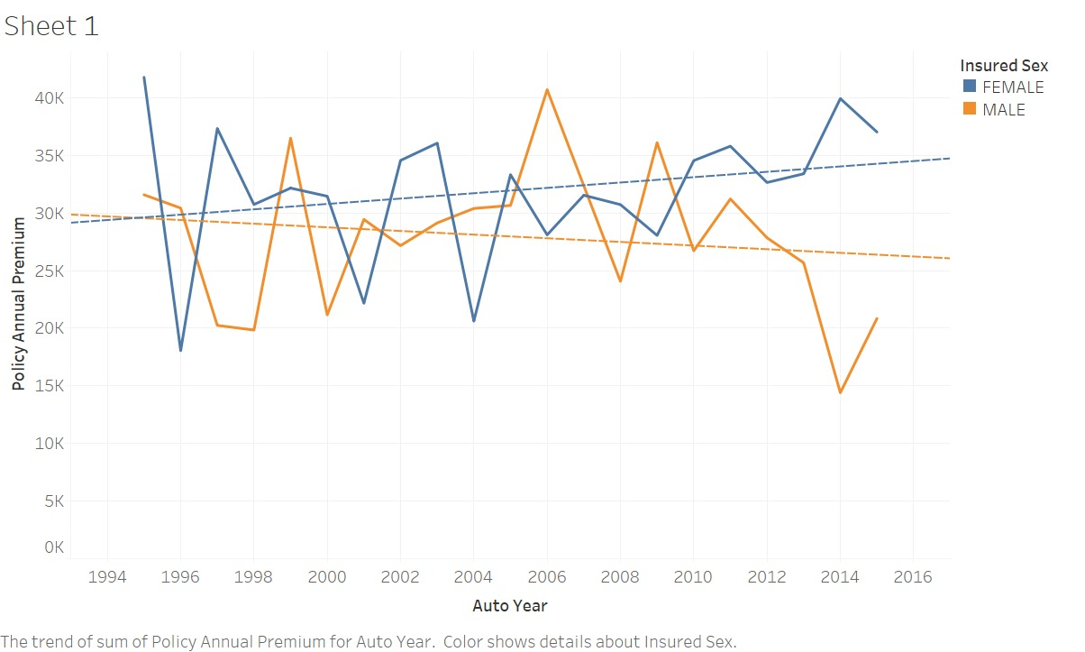
Analyse for both gender premium amount and total claim amount.

Slide 29
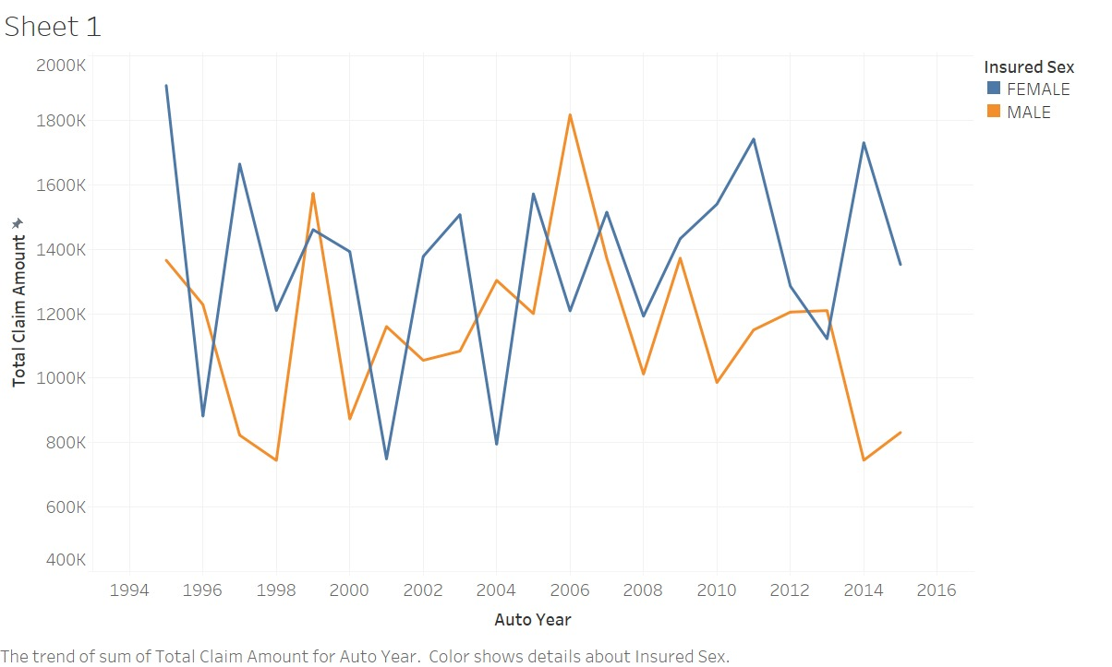
This graphs helps understand the relation of both genders in accordance to auto-mobile year vs the total claim amount and premium paid.
It first plot interprets that females have slightly higher premium amount than males.
Additionally, the premium amount has higher trend for females with auto years that are older as compared to males.
Lastly the claim is lower for males for new vehicles as compared females.

Slide 30
Conclusion

Slide 31
Our analysis conclude that policies are brought for all age groups starting 18 years to 64 year. And females have more accidents as compared to males, wherein they also have more ration in all severity class. It can be observed that New York, South Carolina and West Virginia have the highest number of accidents. Additionally, except for trivial damage all other severity class have larger values, implying more claim amounts. Further, police was called for majority of the incidents and many accidents did not call any authority, which should be noted. Importantly, The total claim amount is higher for females then males.

Slide 32
Recommendations

Slide 33
Since demographic data according to the pattern observed highlights that some states especially, New York, South Carolina and West Virginia have more number of accidents, thus the policy makes need to increase the premium amount for vehicles in that areas. Also it is highly recommended that the premium amount must be set considering the same for other four states.
As females have higher ration in the claim amount and also severity class the premium and coverage for them should also be increased to maximize profit.
Importantly, for policy holders that had total loss, and major loss the amount of premium should be increased for upcoming term. Similarly for minor loss claim policy holders the amount can be increased but at comparatively lower rates (this recommended as though the amount is claim small but according to data the number of such incident is huge, which implies the sub total claim amount could be higher. )
Lastly, for incidents that did not call any authorities after the accident and yet applied for claim amount should be red flag due to higher probability of them being fraudulent.

Slide 34
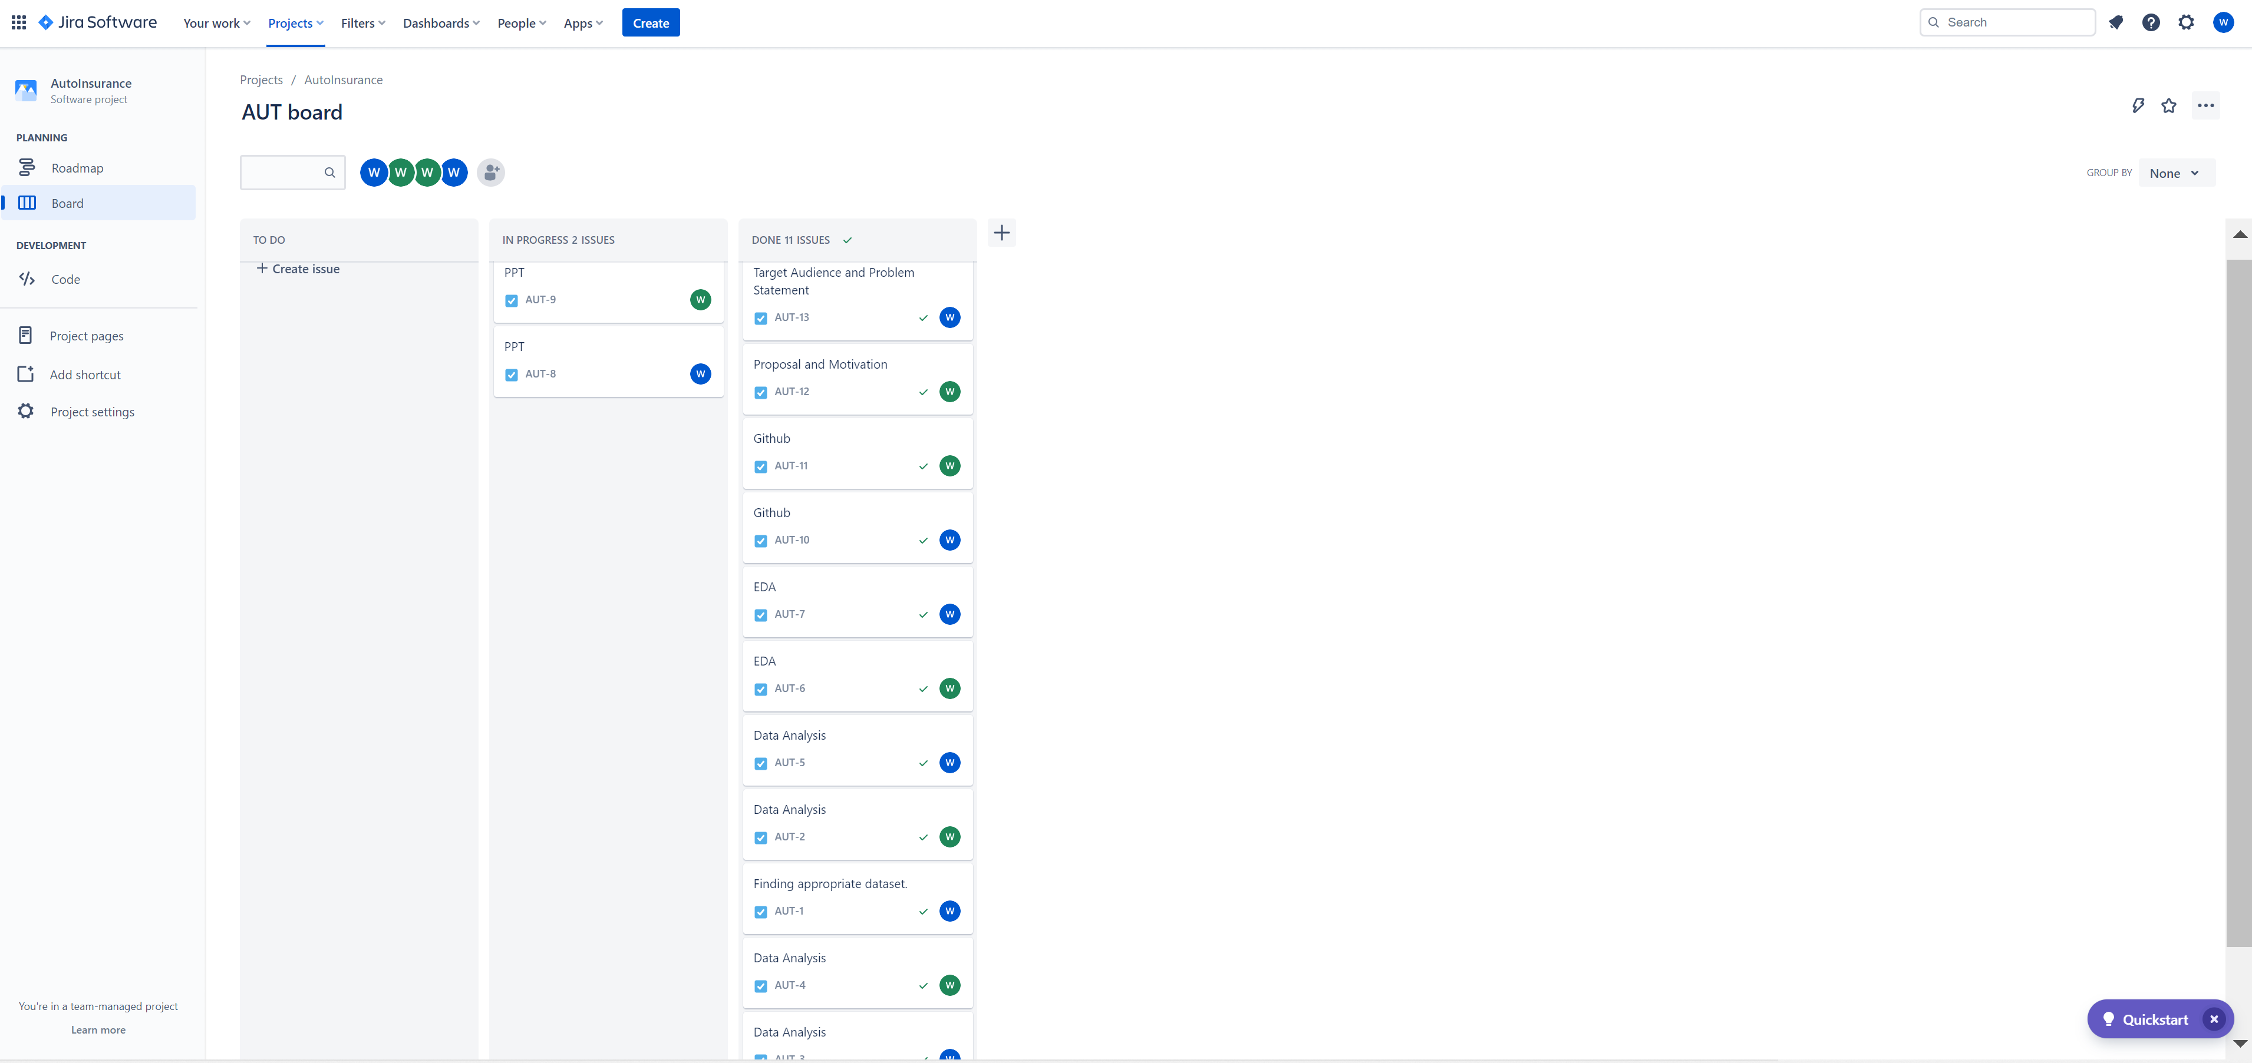
JIRA Dashboard

Slide 35
Github work
https://github.com/Jaymangrolia21/DAB-103-004

Slide 36
Reference
https://databricks-prod-cloudfront.cloud.databricks.com/public/4027ec902e239c93eaaa8714f173bcfc/4954928053318020/1058911316420443/167703932442645/latest.html
https://unacademy.com/content/jee/study-material/mathematics/symmetrical-distribution/
https://www.semutual.nb.ca/news/insurance-fraud/

